Slide 1

The Time is Now: Truthfully assessing achievements in Indigenous curriculum, while leading for future success.
Professor Susan Page
Pro Vice-Chancellor Indigenous Education
17/7/25

Slide 2
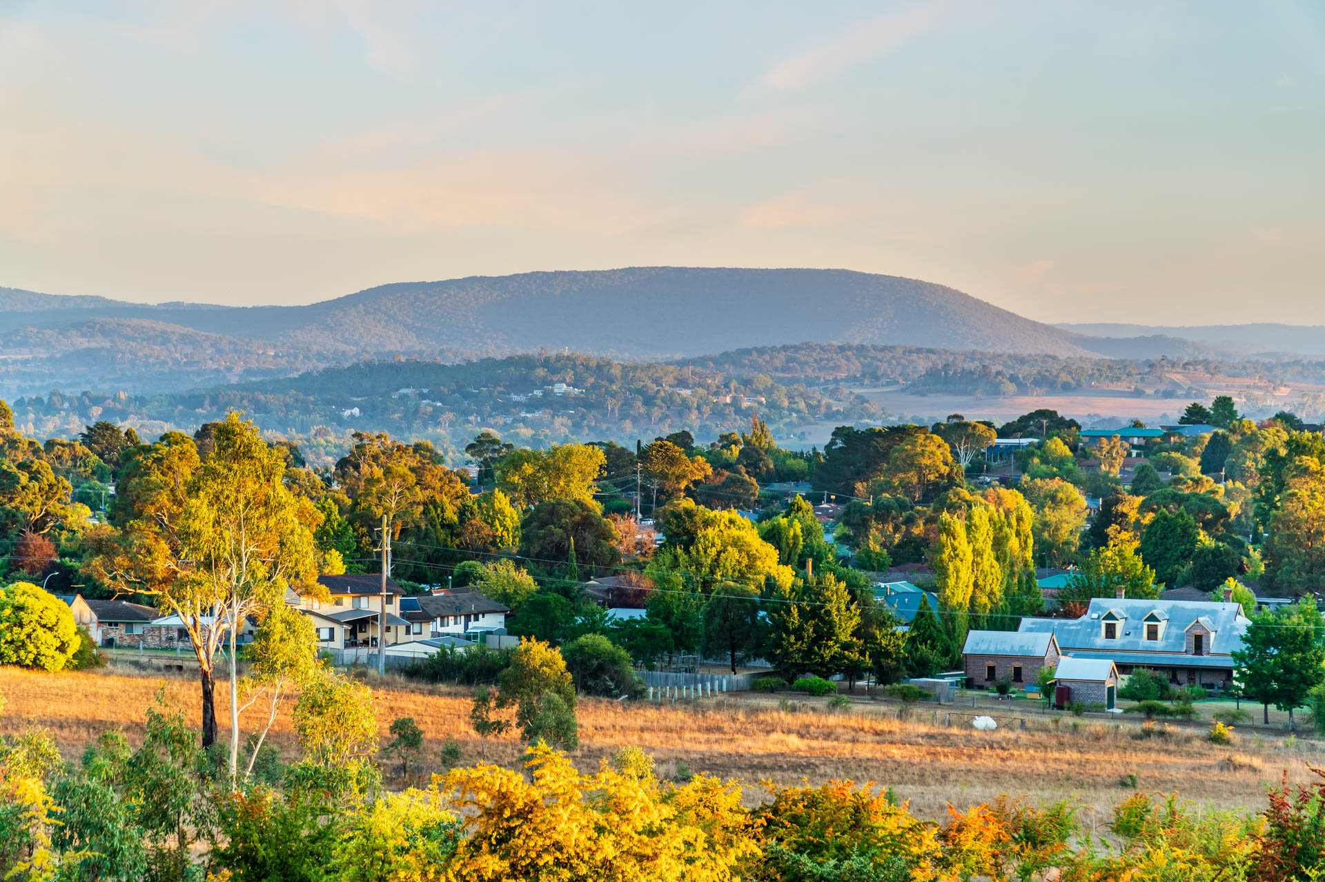
https://www.armidaletownandcountry.com.au/
I acknowledge the Anaiwan (Nganyaywana) peoples as custodians of the land. I pay my respects to their Ancestors and Elders, past and present.

Slide 3
Presentation Overview
Context
Institution
Program
Discipline
Individual

Slide 4
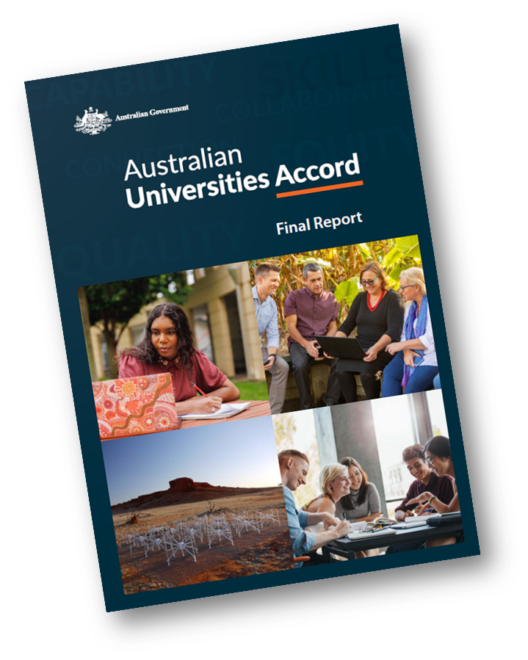
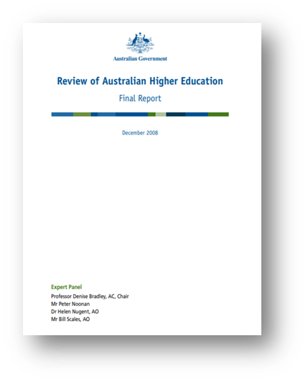
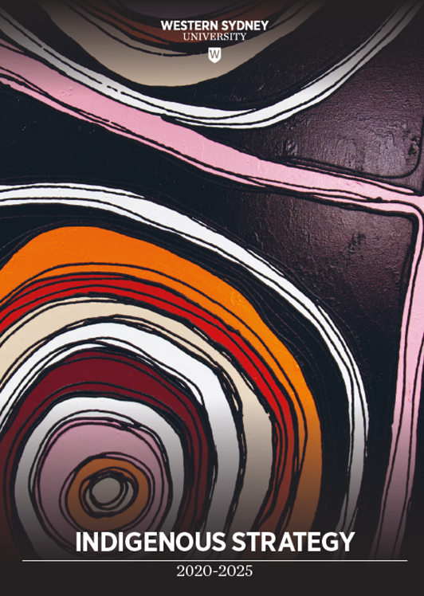
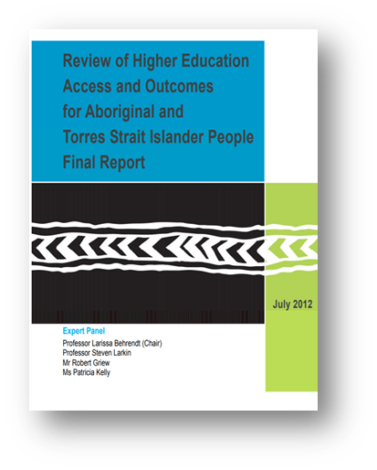
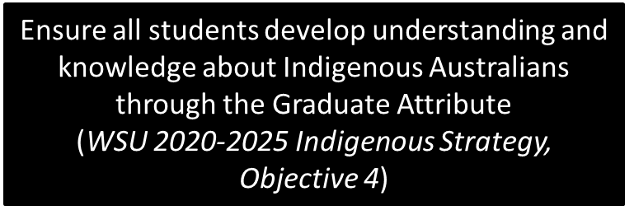
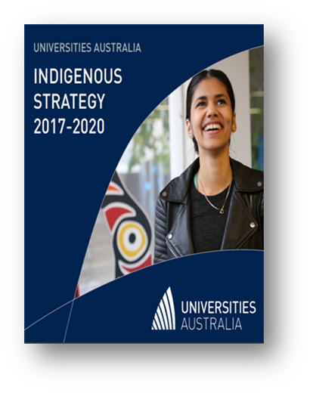
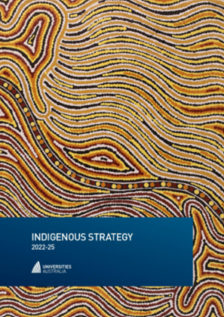
Page, S., Trudgett, M. & Sullivan, C. (2017). Past, present and future: Acknowledging Indigenous achievement and aspiration in higher education. HERDSA Review of Higher Education.
Putting First Nations at the heart of Australia’s higher education system
First Nations students, culture, knowledge, research and communities should be at the heart of the Australian system of higher education. Participation in higher education is a pathway to success for First Nations families and their communities, and building First Nations cultures and knowledge more strongly into the fabric of our national institutions will enrich our whole society.

Slide 5

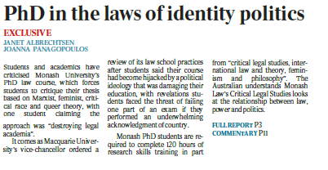
Indigenous Learning and Teaching
‘Indigenising’
curriculum
all politics,
not law
What does Acknowledgement of Country have to do with learning the law?
Warm welcome to country or Macquarie University students fail
Welcome to country or fail course’ convener doubles down

Slide 6
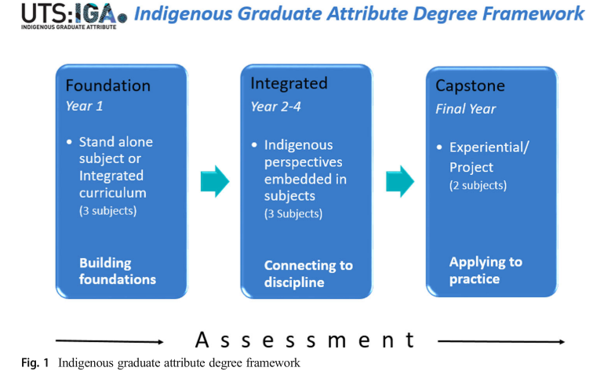
Where to start?

Slide 7

Indigenous Learning and Teaching
Transforming Curriculum
White Mastercript (Ladson-Billings, 1998)
Remedying silences and gaps (Bodkin-Andrews, Page, Trudgett, 2018)
Addressing colonial storytelling (Behrendt, 2016)
Potential Pitfalls
Teacher uncertainty (Wolfe et al, 2018)
Student resistance (Bullen & Flavell, 2017)
Lack of human resources.

Slide 8
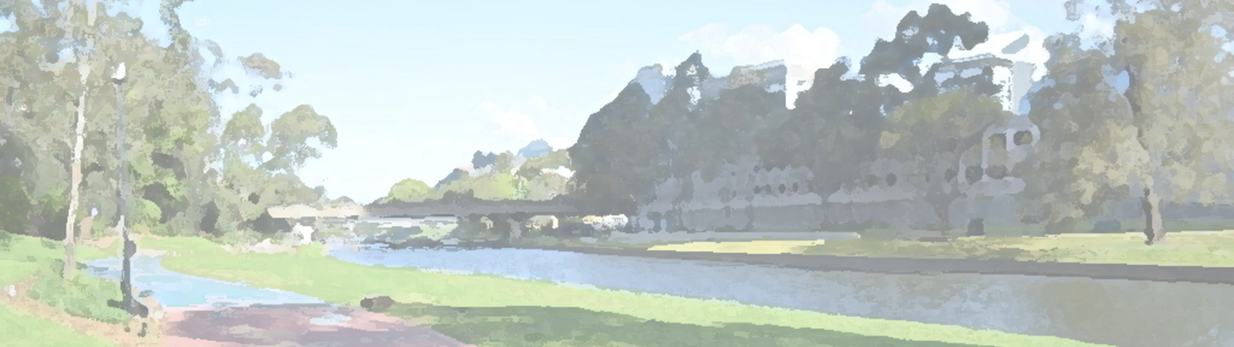

Transformed Teaching
Non-Indigenous academics do not have to become experts, rather they need to be ‘knowledgeable and receptive’ and prepared to work through any discomfort in order to ‘know’ rather than ‘unknow’. And to share the burden of harm and the critical work of Indigenising curriculum (Bessarab, 2015, 2).
Student resistance can result in negative evaluations of teaching (Bullen & Flavell,2017)
Lack of confidence in teaching Indigenous curriculum (Wolfe et al, 2018)
Racism and prejudice (Fredericks 2009; Thunig & Jones 2020)
Page, S. (2022). Persistence, Patience and Persuasion: Critical Reflections on Creating Space for Indigenous Content in Australian University Curricula. Gender in an Era of Post-truth Populism: Pedagogies, Challenges and Strategies, 113-130.

Slide 9
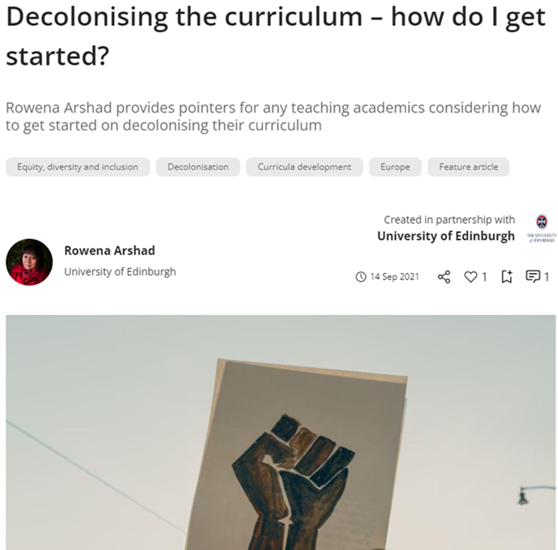
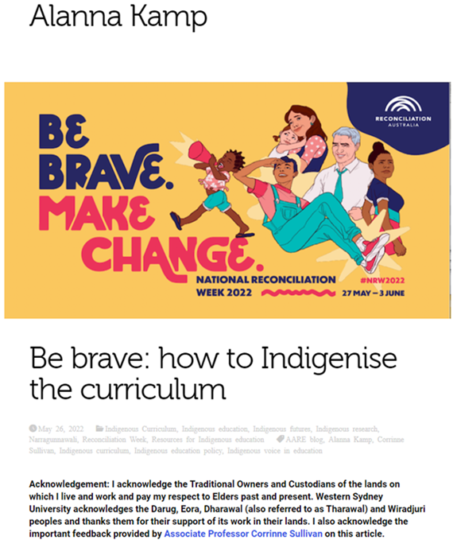
Subject Leaders: Where to start
https://www.timeshighereducation.com/campus/decolonising-curriculum-how-do-i-get-started
https://www.aare.edu.au/blog/?tag=alanna-kamp

Slide 10
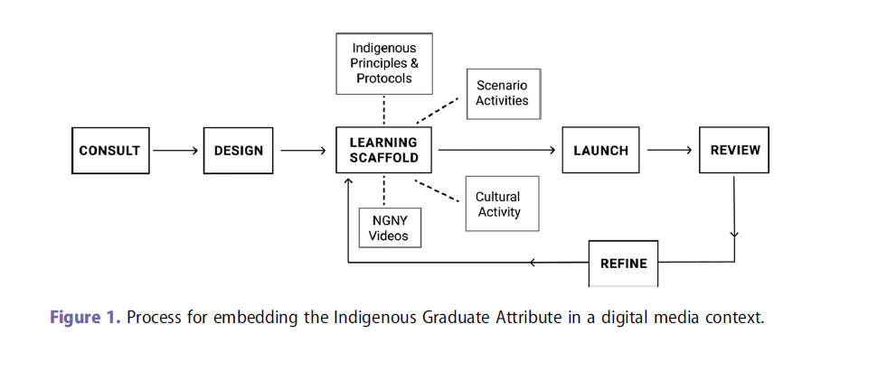
Indigenous Learning and Teaching
A Possible Plan of Attack
Heyward, M., & Krikowa, N. (2023). Embedding Indigenous cultural competencies within a digital media and communication context in Australian higher education. Higher Education Research & Development, 42(2), 350-365.
Notes:
This might be one place to start if you are a subject coordinator.
A word about students – we have over 800 Indigenous students at Western and I know you have large numbers as well. When we think of Indigenous curriculum, we often have non-Indigenous students in mind. Please be aware that there may be Indigenous students in your classrooms – they are there to learn, not to teach.
These teachers took a risk, they were brave, and it paid off in terms of their curriculum and student learning. That can happen for you as well, if it hasn’t already.

Slide 11
Indigenous Learning and Teaching
What curriculum story will your graduates tell?
Notes:
As you go away today (but don’t leave me yet – there are two more slides -, I want to leave with something to ponder.
What curriculum story will your graduates tell?
Once of business graduates told me they had hardly any Indigenous curriculum.

Slide 12
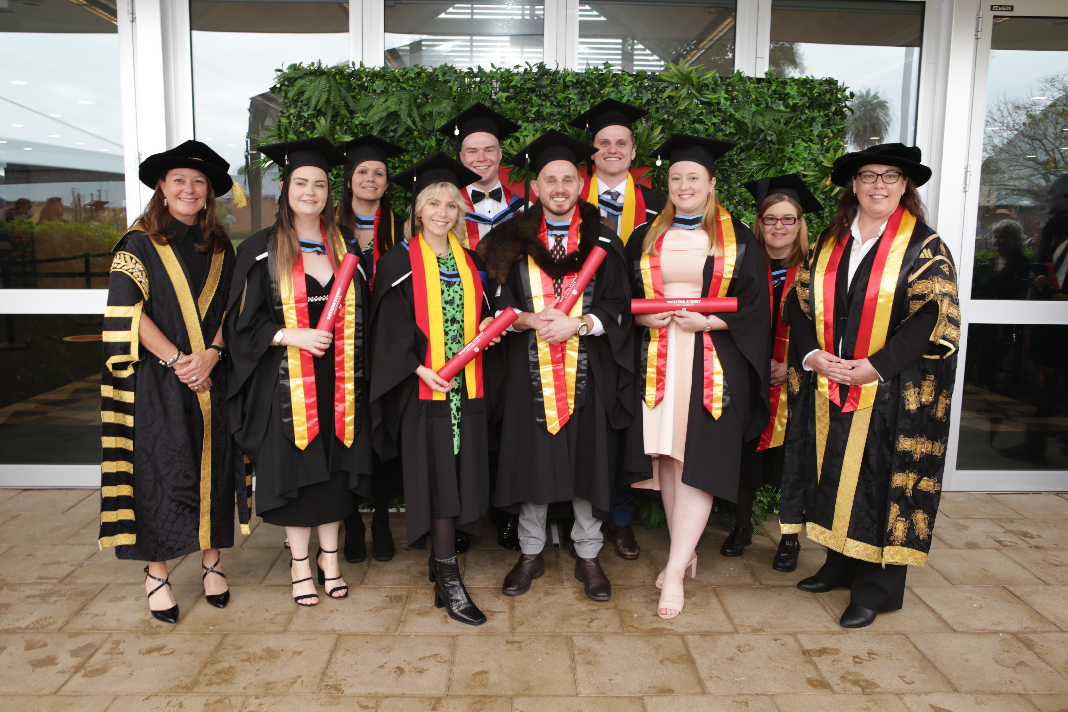
Indigenous Learning and Teaching
Creating an Indigenous Learning and Teaching Culture
Staffing
Policy
(Communities of) Practice
Rewards and Recognition
Page, S., Trudgett, M., & Bodkin-Andrews, G. (2019). Tactics or strategies? Exploring everyday conditions to facilitate implementation of an Indigenous graduate attributes project. Journal of Higher Education Policy and Management, 41(4), 390-403.
Notes:
This is where we can really lead for success into the future.
Policy – Graduation Attributes, mapping when doing curriculum renewal or new programs.
In 2023, the most common example described by institutions was an Indigenous graduate attribute.
13 institutions referenced a graduate attribute, 12 of which described a specific course(s) designed
to ensure that students graduate with an awareness of Indigenous knowledge.
Some institutions have a compulsory stand-alone subject, often at first year – (not enough for me), particular disciplines have mandatory requirements.
Communities of Practice - seminars, L&T week, showcase staff success
Rewards and Recognition – grants, awards, local (school) and uni
For me – connections and relationships.

Slide 13
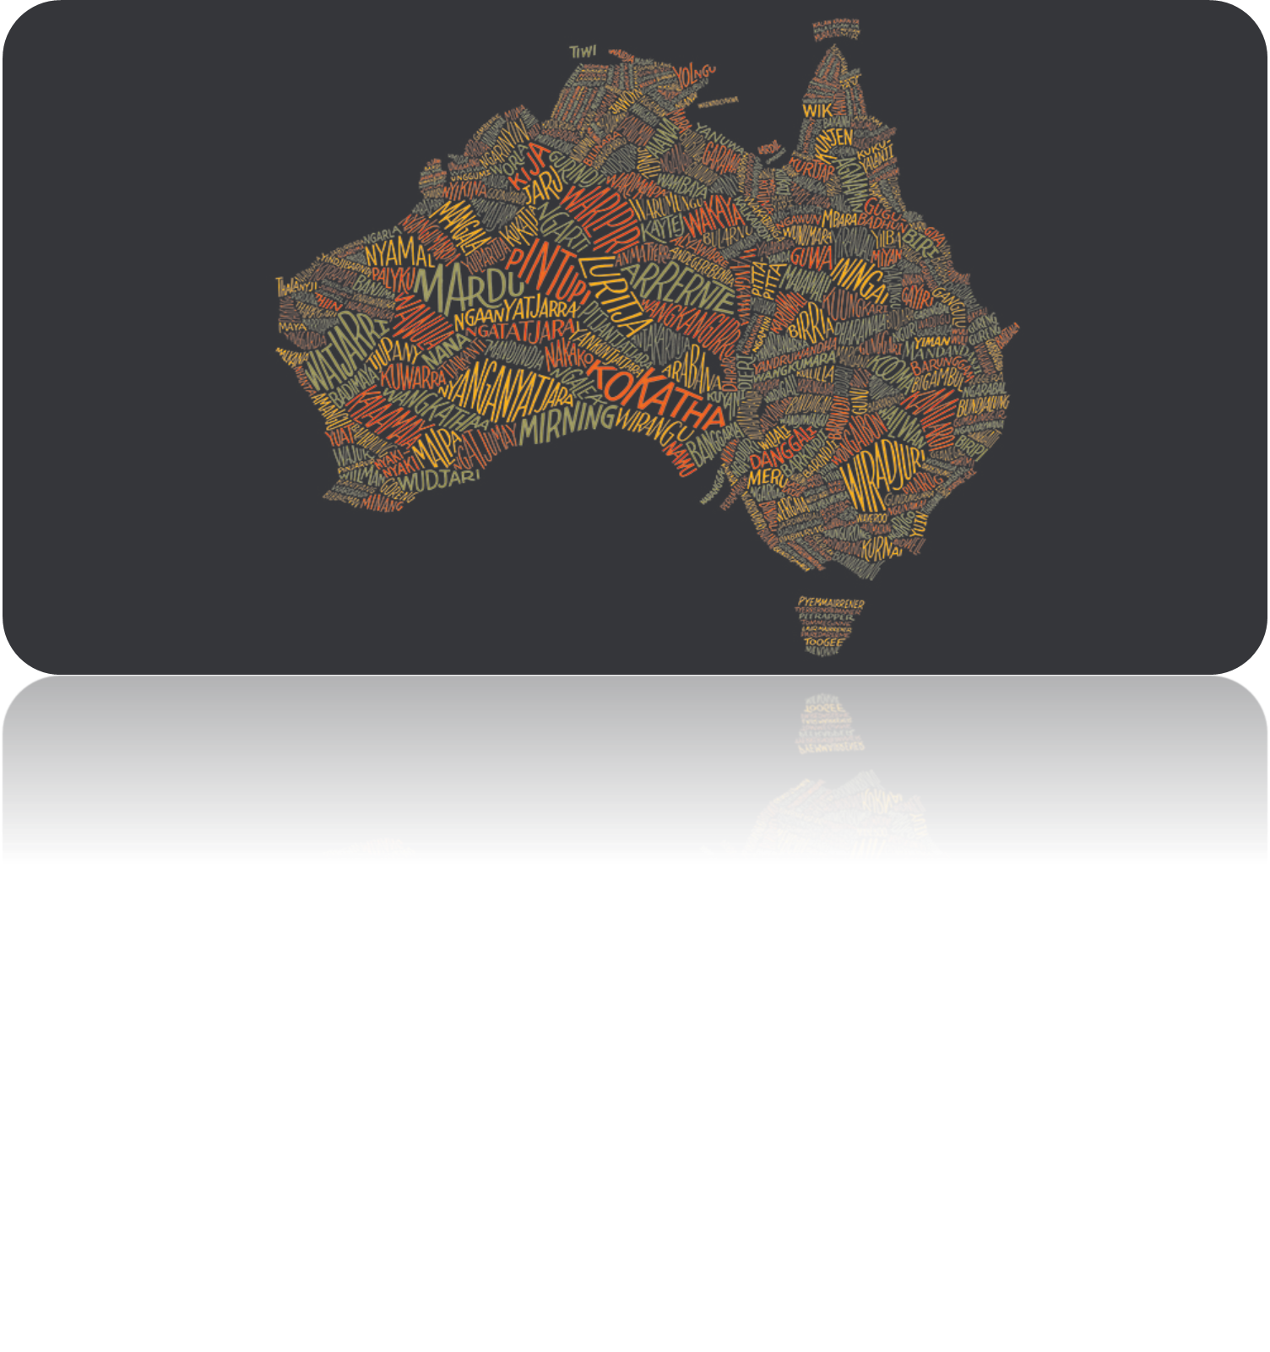
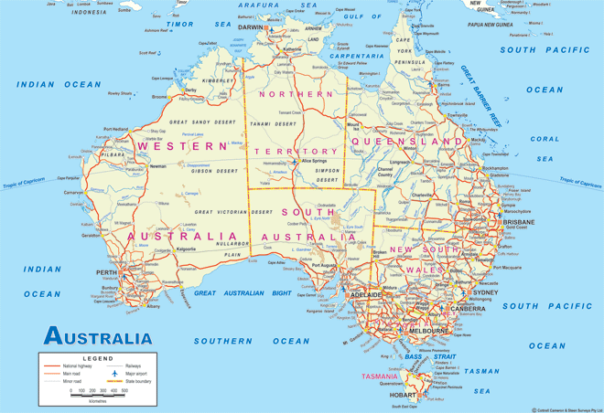
Why is Indigenous Curriculum Important?
Transformative learning seeks to make ‘‘frames of reference
more inclusive, discriminating, open, reflective
and emotionally able to change’’
(Dirkx, Mezirow, & Cranton, 2006, p. 124).

Slide 14

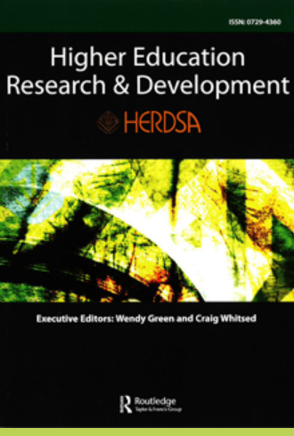
Ō tātou reo, Na domoda, Kuruwilang birad:
Indigenous voices in higher education
Meegan Hall, Sereana Naepi & Susan Page
Thank you.
Questions
s.page@westernsydney.edu.au
Notes:
Please look out for this HERD special edition, some of the papers are on the topic of Indigenous curriculum.

