Slide 1
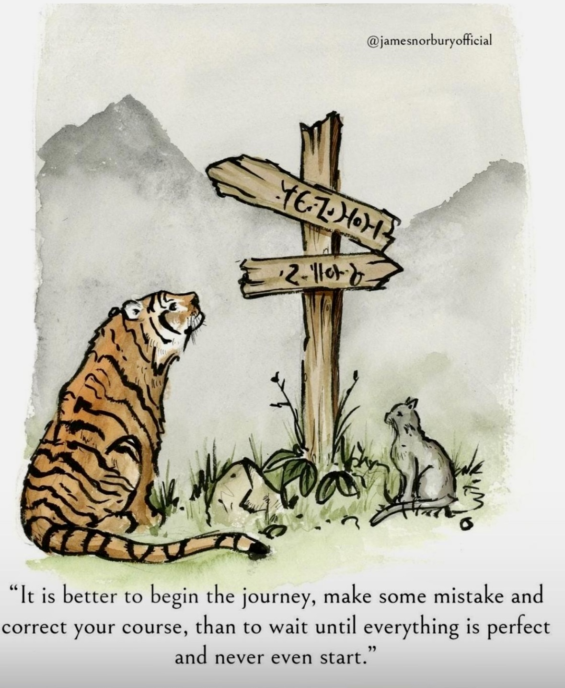
AD Need Assessment Survey
Major findings and AD planning
Dr Kashmira Dave
Academic Development

Slide 2
AD Need Assessment Survey
Runs every Feb – Mar every year
It asks some basic questions related to
  Professional Development needs
  Effectiveness of the new programs
  Any new ideas that you want AD to explore
The data is analysed
The AD activities are planned accordingly

Slide 3
2025 survey participation

Slide 4
Years of Experience in L&T in HE

Slide 5
AD: Scope
Enhancing Scholarship of Learning and Teaching (SoTL) development
  AHE Fellowship
  Conducting Learning and Teaching (L&T) events: Symposia and webinars
  Producing on-demand SoTL-related micro-learning modules
Deliver on-demand capacity-building workshops
Coordinating and supporting citations and awards
  School, Faculty and VC’s citation
  AAUT Awards
  RUN awards
Contribution to specialised projects on request

Slide 6
Findings: Main themes
  Barriers to academic development in the area of teaching and teaching
  Teaching Recognition and Evaluation
  Additional Academic Development Needs
  Academic Development Recognition Preferences
  Better promotion of existing myLearn modules

Slide 7
Findings
Technology and digital learning challenges
Regular peer observation and feedback systems
Recognition of teaching excellence
Technical training on AI tools and applications
Redesigning assessment with GenAI
Free graduate cert qualifications for all academic staff
Support for applying for teaching awards

Slide 8
Findings
Professional development specifically for teaching-focused academics
Structured learning pathways for career advancement
Indigenous perspectives integration across the curriculum
Assessment design
Learning theories application to practice
Diverse student needs accommodation
Student engagement strategies
Indigenous curriculum integration

Slide 9
Academic Development Recognition
Immediate acknowledgment (certificates)
Long-term credentialing (formal qualifications)
External validation (professional bodies)
Recognitions aligned with the promotion process

Slide 10
What AD is doing about this?
Peer Review of Teaching is launched today. Any academic staff can participate. Staff can use this developmental process for promotion and PPDR.
Certificates are provided for participation in academic development activities
University-wide supported Advance HE fellowship program is offered to all staff
On-demand workshops and assistance are offered on request. Few faculties/schools have taken advantage of it
The SoTL framework is being developed which will provide developmental pathway to academics

Slide 11
What AD is doing about this?
Many modules are available for staff for self-paced PD e.g Constructive alignment, AI in teaching and assessment, Teaching Online (developed by LD team)
An induction suite for new academics is being developed and will be available around T3
Academic mentors and reviewers pool is created. The formal training for mentors is being developed

Slide 12
University-wide initiatives
Different units of the university can help in gaining different skills
This year, university-wide recognition and awards are offered for all staff
Learning technology support is available through the learning design team.
Skill | Support available from
Digital learning skills | Learning Desing team
AI skills | LN70
Data analysis | Graduate Research School

Slide 13
Academic Development idea
Pl share:
academicdevelopment@une.edu.au
If you have a professional development need, communicate to academic development

